Slide 1
The Network Simulator :
TCP and UDP

Slide 2
Creating Event Scheduler
# define a simulated object
  set ns [new Simulator]
# defined a finished procedure
  proc finish { } {
  exit 0
  }
# set the finished time
  $ns at 5.0 “finish”
# start to simulate
  $ns run

Slide 3
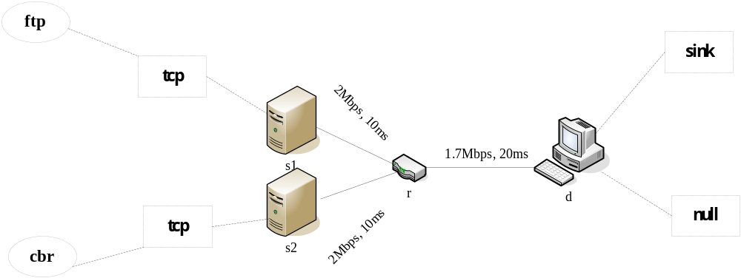
The Network Topology

Slide 4
Analysis
+ 0.1 1 2 cbr 1000 ------ 2 1.0 3.1 0 0
- 0.1 1 2 cbr 1000 ------ 2 1.0 3.1 0 0
+ 0.108 1 2 cbr 1000 ------ 2 1.0 3.1 1 1
- 0.108 1 2 cbr 1000 ------ 2 1.0 3.1 1 1
r 0.114 1 2 cbr 1000 ------ 2 1.0 3.1 0 0
Event | Time | From | To node | Pkt node | Pkt type | Flags size | Fid | Src addr | Dst addr | Seq num | Pkt id
r : receive (at to_node)
+: enqueue (at queue) src_addr: node.port
: dequeue (at queue) dst_addr: node.port
d: drop (at queue)

Slide 5
awk
一 | 二 | 三 | 四 | 五 | 六 | 七 | 八 | 九 | 十 | 十一 | 十二
+ | 0.1 | 1 | 2 | Cbr | 1000 | ----- | 2 | 1.0 | 3.1 | 0 | 0
Variables | means
$0 | The line of data
$1 | The first column of data from $0
$2 | The second column of data from $0
…… | ……

Slide 6
awk
Step 1:
  Reading the data from the file.
Step 2:
  Updating these variables
Step 3:
  Executing all of the Pattern commands.
Step 4:
  If the file had data, to repeat Step 1 to Step 4.

Slide 7
gnuplot
Axis
  xtics, ydtics, ……
  grid
  logscale
  autoscale, xrange, yrange, ……
  xzeroaxis, yzeroaxis

Slide 8
gnuplot
Label
  arrow
  key, label, title, xlabel, ylabel
Style
  lines, points, linespoints
  impulses
  dots
  steps
  errorbars

